Slide 1
AWS EKS and ECR

Slide 2
Overview of Amazon EKS
◆ Amazon Elastic Container Service for Kubernetes (Amazon EKS) is a managed service that makes it easy for you to run Kubernetes on AWS without needing to stand up or maintain your own Kubernetes control plane.
12
Amazon EKS runs Kubernetes control plane instances across multiple Availability Zones to ensure high availability.
Amazon EKS automatically detects and replaces unhealthy control plane instances, and it provides automated version upgrades and patching for them.
Amazon EKS is also integrated with many AWS services to provide scalability and security for your applications, including the following:
Elastic Load Balancing for load distribution
IAM for authentication
Amazon VPC for isolation

Slide 3
EKS Benefits
High Availability
EKS supports Fargate -serverless compute
Very Secure
Built with the Community

Slide 4
Use Cases
Hybrid Deployment
Kubeflow with EKS for machine learning
Run sequential or parallel batch workloads
Easily build applications

Slide 5
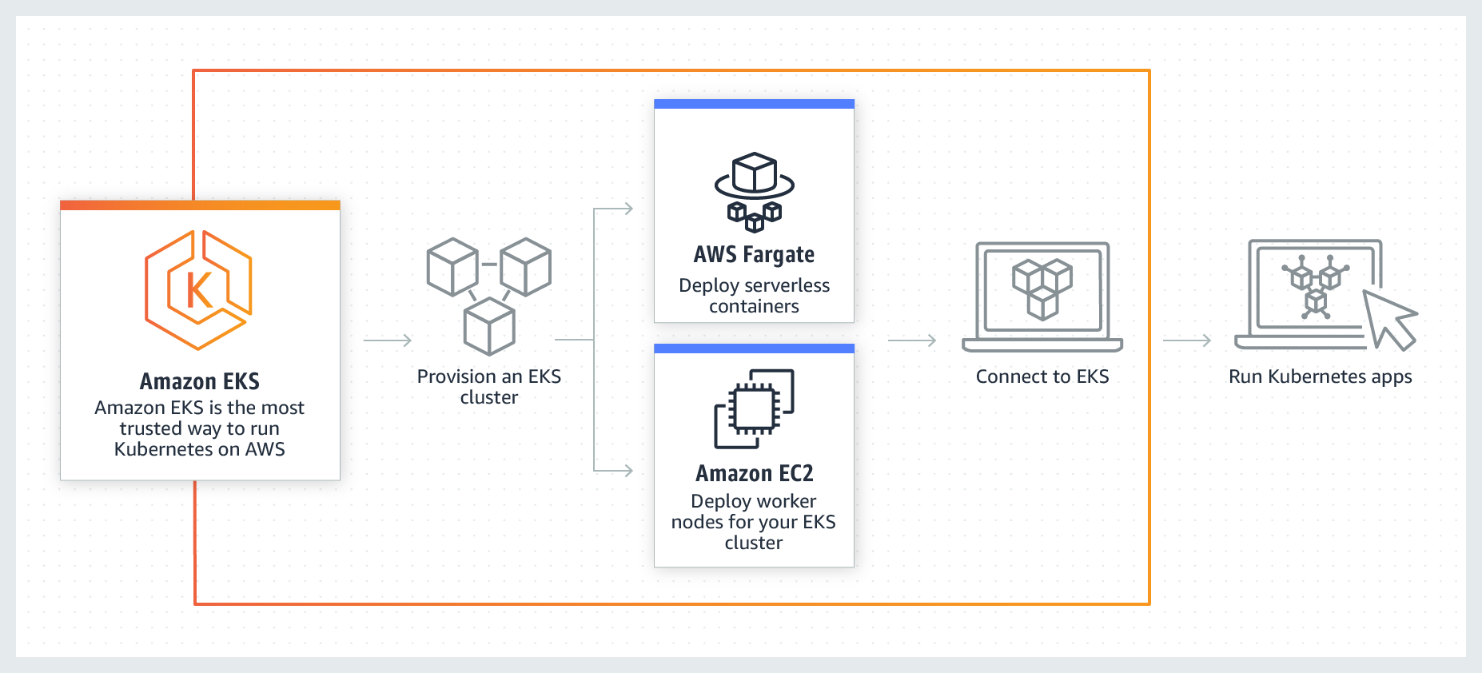
Working of EKS
13

Slide 6
EKS Kubernetes - Architecture
Master
Worker Node -1
EKS Controller Manager
Fargate Controller Manager
Kubelet
Kube-Proxy
Container Runtime (Docker)
kube-apiserver
Worker Node - 2
etcd
kube-scheduler
Kubelet
Kube-Proxy
Container Runtime (Docker)
Container Runtime (Docker)
EKS Control Plane
EKS Node Group

Slide 7
Managed Kubernetes Clusters
Managed Control Plane:
The Amazon EKS service automatically manages the availability and scalability of the Kubernetes API servers and the etcd persistence layer for each cluster.
Amazon EKS runs the Kubernetes control plane across three Availability Zones in order to ensure high availability, and it automatically detects and replaces unhealthy masters.
Managed Worker Nodes:
Create, Update, or Terminate worker nodes for your cluster with a single command.
Managed node groups run nodes uses the latest EKS-optimized AMIs to ensure applications are highly available

Slide 8
EKS Cluster – Components
EKS Control Plane
EKS runs a single tenant Kubernetes control plane for each cluster, and control plane infrastructure is not shared across clusters or AWS accounts.
This control plane consists of at least two API server nodes and three etcd nodes that run across three Availability Zones within a Region
EKS automatically detects and replaces unhealthy control plane instances, restarting them across the Availability Zones within the Region as needed.
Worker Nodes
&
Node Groups
Worker machines in Kubernetes are called nodes. These are EC2 Instances
EKS worker nodes run in our AWS account and connect to our cluster's control plane via the cluster API server endpoint.
A node group is one or more EC2 instances that are deployed in an EC2 Autoscaling group.
All instances in a node group must
Be the same instance type
Be running the same AMI
Use the same EKS worker node IAM role

Slide 9
EKS Cluster – Core Objects Detailed
Fargate Profiles
AWS Fargate is a technology that provides on-demand, right-sized compute capacity for containers
With Fargate, we no longer have to provision, configure, or scale groups of virtual machines to run containers.
Each pod running on Fargate has its own isolation boundary and does not share the underlying kernel, CPU resources, memory resources, or elastic network interface with another pod.
AWS specially built Fargate controllers that recognizes the pods belonging to fargate and schedules them on Fargate profiles.
VPC
EKS uses AWS VPC network policies to restrict traffic between control plane components to within a single cluster.
Control plane components for a EKS cluster cannot view or receive communication from other clusters or other AWS accounts, except as authorized with Kubernetes RBAC policies.
This secure and highly-available configuration makes EKS reliable and recommended for production workloads.

Slide 10
EKS Kubernetes - Architecture
Master
Worker Node -1
EKS Controller Manager
Fargate Controller Manager
Kubelet
Kube-Proxy
Container Runtime (Docker)
kube-apiserver
Worker Node - 2
etcd
kube-scheduler
Kubelet
Kube-Proxy
Container Runtime (Docker)
Container Runtime (Docker)
EKS Control Plane
EKS Node Group

Slide 11
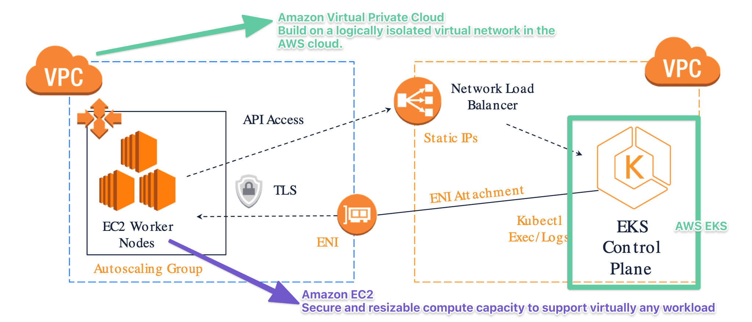
EKS using ec2

Slide 12
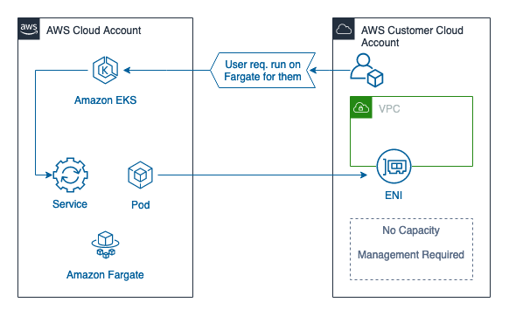
EKS Fargate

Slide 13
Overview of ECR
Fully-managed Docker container registry that makes it easy for developers to store, manage, and deploy Docker container images.
Integrated with Amazon ECS and Amazon EKR , simplifying development to production workflow.
Eliminates the need to operate own container repositories or worry about scaling the underlying infrastructure.
Integrates with AWS Identity and Access Management (IAM) provides resource-level control of each repository.
No upfront fees or commitments, pay only for the amount of data you store in your repositories and data transferred to the Internet

Slide 14
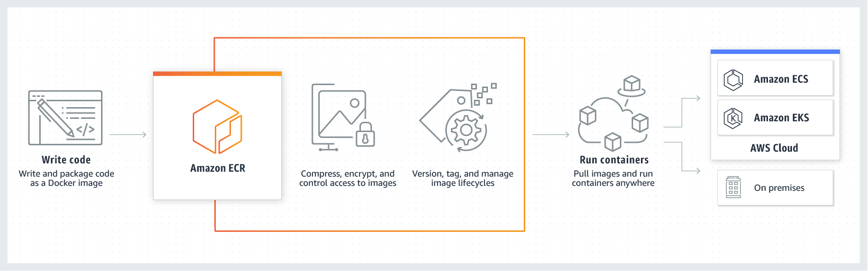
Working of ECR

Slide 15




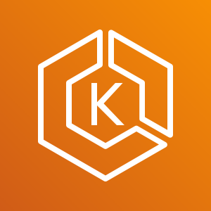

Working of ECR
Developer
Docker Container
Push Images
Elastic Container Service - ECS
Pull Images and Run Containers
Docker Image
Docker Container
Pull Images
Elastic Container Registry - ECR
Elastic Kubernetes Service - EKS
Docker Container
On-Premise

Slide 16
14
@2018-CHAITANYA R GAAJULA - ALL RIGHTS RESERVED
THANK YOU
THANK YOU

